Slide 1

Cloud Computing

Slide 2

Agenda
Introduction
Cloud Deployment Models
Cloud Computing Models
Virtualization and Scalability
Identity and Access Management
Encryption Methods and Protocols

Slide 3

INTRODUCTION
What is Cloud Computing?
Cloud computing is a technological advancement it is based on the concept of dynamic provisioning*, which is applied not only to services but also to compute capability, storage, networking, and information technology (IT) infrastructure in general.
*Dynamic Provisioning: Efficiently manages server resources by activating only the necessary number of servers to meet the current and future demand, while putting unused servers in sleep mode.
Cloud computing allows renting infrastructure, runtime environments, and services on a pay per-use basis. End users leveraging cloud computing services can access their documents and data anytime, anywhere, and from any device connected to the Internet.

Slide 4
INTRODUCTION
What is Cloud Computing?
Cloud computing refers to both the applications delivered as services over the Internet and the hardware and system software in the datacenters that provide those services.
A cloud is a type of parallel and distributed system consisting of a collection of interconnected and virtualized computers that are dynamically provisioned and presented as one or more unified computing resources based on service-level agreements established through negotiation between the service provider and consumer.

Slide 5

Cloud Deployment Models
Let’s Dive In

Slide 6

Cloud Deployment Models
Cloud computing is a type of remote computer network hosting, where massively distributed computers are connected to the Internet and made available through Internet Protocol networks such as the Internet.
The three major models for deploying and accessing cloud computing environments are:
Public clouds,
Private/Enterprise clouds,
Hybrid clouds.

Slide 7
Cloud Deployment Models
Public Cloud
A Public Cloud is Cloud Computing in which the infrastructure and services are owned and operated by a third-party provider and made available to the public over the internet.
The public can access and use shared resources, such as servers, storage, and applications and the main thing is you pay for what you used only. Examples of public cloud providers – are Amazon Web Services (AWS), Microsoft Azure, and Google Cloud Platform (GCP).
Advantages: Cost Effective
Automatic Software Updates
Accessibility
Disadvantages: Security and Privacy Concerns
Limited Control

Slide 8
Cloud Deployment Models
Private Cloud
A Private Cloud is a cloud computing environment in which the infrastructure and services are owned and operated by a single organization, for example, a company or government, and it is accessed by only authorized users within that organization.
Private Cloud organizations have their own data center. private cloud provides a higher level of security. Examples – HPE, Dell, VMware, etc.
Advantages: Security Status
Customization of Service
Privacy
Disadvantages: Higher Cost
Maintenance and Upgrades

Slide 9
Cloud Deployment Models
Hybrid Cloud
A hybrid cloud is a combination of both public and private cloud environments that allows organizations to take advantage of the benefits of both types of clouds.
It manages traffic levels during peak usage periods. It can provide greater flexibility, scalability, and cost-effectiveness than using a single cloud environment. Examples – IBM, DataCore Software, Rackspace, Threat Stack, etc.
Advantages: Hybrid cloud stores its data in a private cloud server. While public server provides Flexibility and Scalability.]
Security
Disadvantages: Higher Cost
Complexity
Security Risks

Slide 10

Cloud Computing Models
LOOKING AHEAD

Slide 11

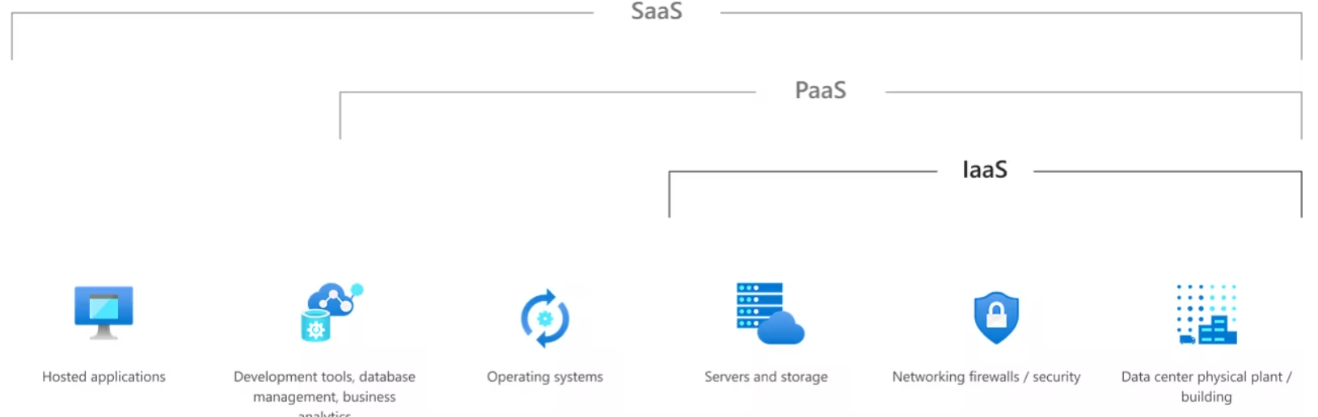
Cloud Computing Models
Cloud Computing can be defined as the practice of using a network of remote servers hosted on the Internet to store, manage, and process data, rather than a local server or a personal computer.
Companies offering such kinds of cloud computing services are called cloud providers and typically charge for cloud computing services based on usage. Grids and clusters are the foundations for cloud computing.
Types of Cloud Computing:
Software as a service (SaaS)
Platform as a service (PaaS)
Infrastructure as a service (IaaS)

Slide 12
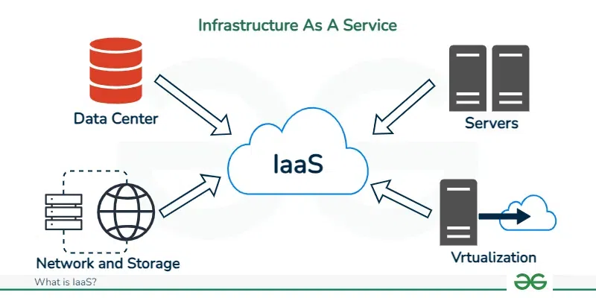
Cloud Computing Models
IaaS
Infrastructure as a service (IaaS) is a type of cloud computing service that offers essential compute, storage, and networking resources on demand, on a pay-as-you-go basis.
Organizations must purchase equipment through procurement processes that can take months. They must invest in physical spaces, typically specialized rooms with power and cooling. And after deploying the systems, they need IT professionals to manage and maintain them.
IaaS lets you bypass the cost and complexity of buying and managing physical servers and datacenter infrastructure. Each resource is offered as a separate service component, and you only pay for a particular resource for as long as you need it.

Slide 13
Cloud Computing Models
IaaS
Common IaaS business scenarios:
Test and development
Storage, backup, and recovery
Web apps
High-performance computing
Advantages of IaaS
Reduces capital expenditures and optimizes costs
Increases scale and performance of IT workloads
Increases stability, reliability, and supportability
Improves business continuity and disaster recovery

Slide 14
Cloud Computing Models
PaaS
Platform as a service (PaaS) is a complete development and deployment environment in the cloud, with resources that enable you to deliver everything from simple cloud-based apps to sophisticated, cloud-enabled enterprise applications.
Like IaaS, PaaS includes infrastructure—servers, storage, and networking—but also middleware, development tools, business intelligence (BI) services, database management systems, and more. PaaS is designed to support the complete web application lifecycle: building, testing, deploying, managing, and updating.
Advantages of PaaS:
Cut coding time
Faster time to market
Low maintenance
Easy scalability

Slide 15
Cloud Computing Models
SaaS
Software as a service (SaaS) allows users to connect to and use cloud-based apps over the Internet. Common examples are email, calendaring, and office tools (such as Microsoft Office 365).
SaaS provides a complete software solution that you purchase on a pay-as-you-go basis from a cloud service provider. You rent the use of an app for your organization, and your users connect to it over the Internet, usually with a web browser.
All of the underlying infrastructure, middleware, app software, and app data are located in the service provider’s data center. The service provider manages the hardware and software, and with the appropriate service agreement, will ensure the availability and the security of the app and your data as well.
Advantages of SaaS:
Gain access to sophisticated applications
Mobilize your workforce easily: No need to develop apps for different types of computers and devices as it has already been done.

Slide 16
Virtualization And Scalability
Let’s Dive In

Slide 17

Virtualization
Virtualization is essentially a technology that allows creation of different computing environments. These environments are called virtual because they simulate the interface that is expected by a guest.
The most common example of virtualization is hardware virtualization. This technology allows simulating the hardware interface expected by an operating system. Hardware virtualization allows the coexistence of different software stacks on top of the same hardware.
These stacks are contained inside virtual machine instances, which operate in complete isolation from each other. High-performance servers can host several virtual machine instances, thus creating the opportunity to have a customized software stack on demand.
This is the base technology that enables cloud computing solutions to deliver virtual servers on demand, such as Amazon EC2, RightScale, VMware vCloud, and others.
Virtualization technologies are also used to replicate runtime environments for programs.

Slide 18
Scalability
Cloud Scalability is the ability of a cloud computing system to adapt to changing computing requirements by either increasing or decreasing its resources, such as computing power, storage, or network capacity on demand.
This type of Scalability is essential because it allows organizations to quickly adjust to the changes in their computing needs while also providing efficient use of computing resources.
The goal of cloud scalability is to make sure that the cloud service can scale cost-effectively and ensure that the service can handle greater loads by adding physical or virtual resources. There are 3 types of Scaling:
Vertical Scalability: Adding more resources (CPU, RAM, storage) to an existing server or system to boost its capacity.
Horizontal Scalability: Adding more servers or instances to distribute the workload, which can increase capacity without changing existing infrastructure.
Diagonal Scalability: Diagonal scalability combines elements of both vertical and horizontal scaling. It allows a system to initially scale vertically (adding more resources to a single machine) and, when that capacity is reached, to scale horizontally by adding more machines or instance

Slide 19

Identity and Access Management
Let’s Dive In

Slide 20

Identity and Access Management
Identity and Access Management (IAM) is a combination of policies and technologies that allows organizations to identify users and provide the right form of access as and when required.
Identity management and access systems enable your organization to manage employee apps without logging into each app as an administrator.
Identity management solutions generally perform two tasks:
IAM confirms that the user, software, or hardware is who they say they are by authenticating their credentials against a database. IAM cloud identity tools are more secure and flexible than traditional username and password solutions.
Identity access management systems grant only the appropriate level of access. Instead of a username and password allowing access to an entire software suite, IAM allows for narrow slices of access to be portioned out, i.e. editor, viewer, and commenter in a content management system.

Slide 21
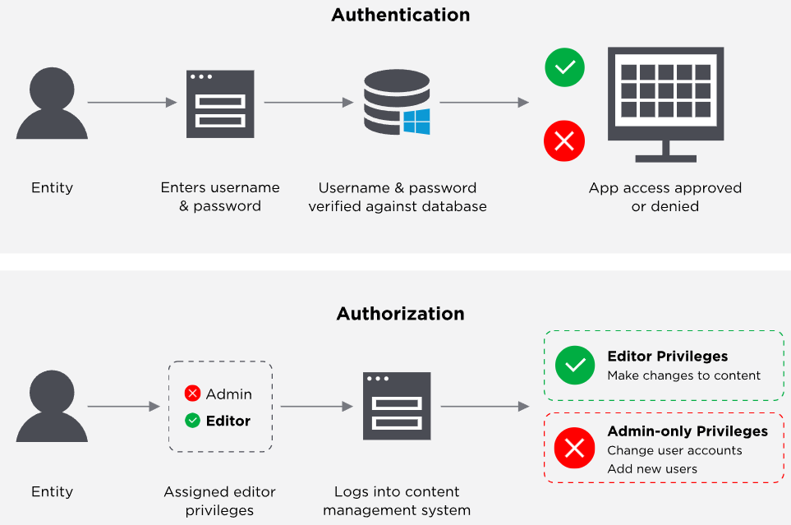
Identity and Access Management
What Does IAM Do?
Manage user identities
Authenticating users
Authorizing users
Reporting
Single Sign-On

Slide 22

Encryption Methods and Protocols
Let’s Dive In

Slide 23

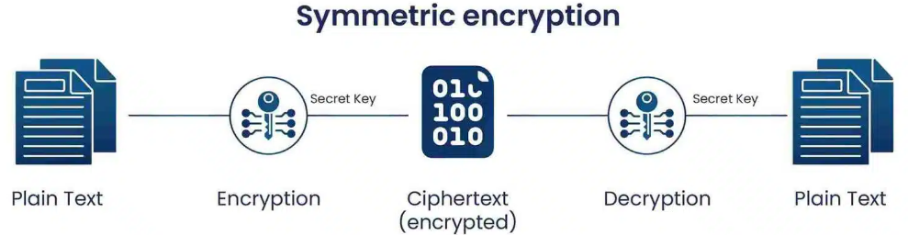
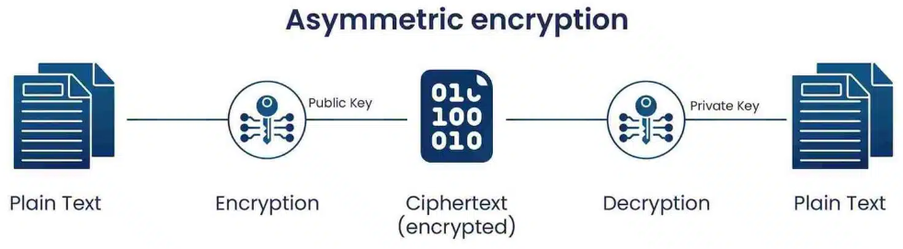
Encryption Methods and Protocols
Encryption is a way of scrambling data so that only authorized parties can understand the information. In technical terms, it is the process of converting human-readable plaintext to incomprehensible text, also known as ciphertext.
There are 2 types of Encryption methods:
Symmetric Encryption: In Symmetric-key encryption the message is encrypted by using a key and the same key is used to decrypt the message which makes it easy to use but less secure.
Asymmetric Encryption: Uses a pair of keys—a public key for encryption and a private key for decryption—allowing secure communication without sharing the private key.

Slide 24
Encryption Methods and Protocols
Encryption Protocol:
TLS/SSL (Transport Layer Security / Secure Sockets Layer): Secures internet communications by encrypting data between clients and servers. Used in HTTPS for secure web browsing.
IPsec (Internet Protocol Security): Secures IP communication by authenticating and encrypting each IP packet in a data stream. Commonly used in VPNs.
SSH (Secure Shell): Provides secure remote access and file transfers by encrypting data between the client and server, commonly used in server management.
FTPS/SFTP (File Transfer Protocol Secure / SSH File Transfer Protocol): Secure protocols for transferring files over a network, with FTPS using TLS/SSL and SFTP using SSH.
HTTPS (Hypertext Transfer Protocol Secure): A secure version of HTTP using SSL/TLS for encrypted web browsing, protecting data integrity and confidentiality.

Slide 25
Encryption Methods and Protocols
SSL/TLS Encryption:
SSL (Secure Sockets Layer) encryption, and its more modern and secure replacement, TLS (Transport Layer Security) encryption, protect data sent over the internet or a computer network.
This prevents attackers (and Internet Service Providers) from viewing or tampering with data exchanged between two nodes—typically a user’s web browser and a web/app server.
Most website owners and operators have an obligation to implement SSL/TLS to protect the exchange of sensitive data such as passwords, payment information, and other personal information considered private.
SSL/TLS uses both asymmetric and symmetric encryption to protect the confidentiality and integrity of data-in-transit. Asymmetric encryption is used to establish a secure session between a client and a server, and symmetric encryption is used to exchange data within the secured session.
A website must have an SSL/TLS certificate for their web server/domain name to use SSL/TLS encryption.

Slide 26
Encryption Methods and Protocols
Advanced Encryption Standard (AES)
AES is a symmetric encryption algorithm widely used to secure data. It uses a block cipher method, meaning it encrypts data in fixed-size blocks of 128 bits. It can work with key sizes of 128, 192, or 256 bits, where larger key sizes offer greater security.
Rounds of Encryption: Depending on the key size, AES performs multiple rounds of encryption and each round includes several operations like SubBytes, ShiftRows, MixColumns, and AddRoundKey to transform and secure the data:
10 rounds for 128-bit keys
12 rounds for 192-bit keys
14 rounds for 256-bit keys
AES is considered highly secure and resistant to all known practical attacks. It is efficient in both hardware and software implementations, making it suitable for various applications, including wireless communications, banking, and secure file storage.
Applications: Wireless security, Database Encryption, Database Encryption, Data storage, etc.

Slide 27
THANK YOU

